Slide 1
Pattern matching

Slide 2
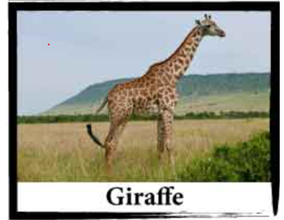
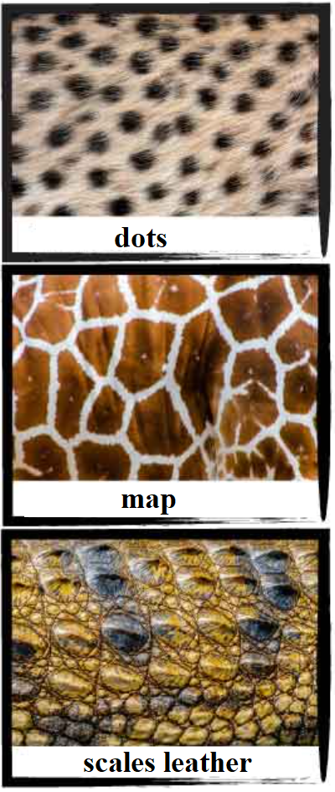
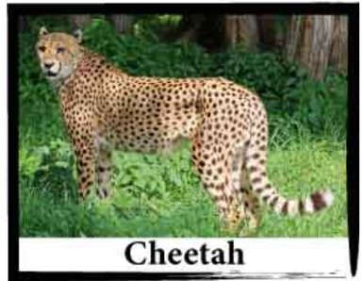
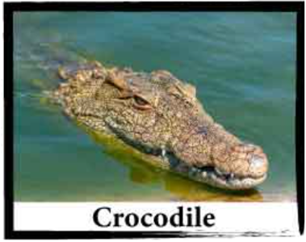
What is it? ...Warm up ;)

Slide 3


What is it? Results*
* Achievement First class elementary school level reached. Congrats! ☺

Slide 4

What is it? Pattern matching.
Eexpressions
Patterns

Slide 5
Pattern matching
pattern matching is a technique where you test an expression to determine if it has certain characteristics
is expression - test an expression and conditionally declare a new variable
switch expression (or statement) - perform actions based on the first matching
Notes:
The "is expression" supports pattern matching to test an expression and conditionally declare a new variable to the result of that expression.
The "switch expression" enables you to perform actions based on the first matching pattern for an expression.

Slide 6

Patterns
Type pattern - check the run-time type of an expression
Declaration pattern - check the run-time type of an expression and, if a match succeeds, assign an expression result to a declared variable
Constant pattern - test if an expression result equals a specified constant
Relational pattern - compare an expression result with a specified constant
Logical pattern - test if an expression matches a logical combination of patterns
Property pattern - test if an expression's properties or fields match nested patterns
Positional pattern - deconstruct an expression result and match the resulting values against the corresponding nested patterns
Var pattern - match any expression, including null, and assign its result to a new local variable
Discard pattern - match any expression, including null
Parenthesized pattern - emphasize or change the precedence in logical patterns
List pattern - match an array or a list against a sequence of patterns

Slide 7
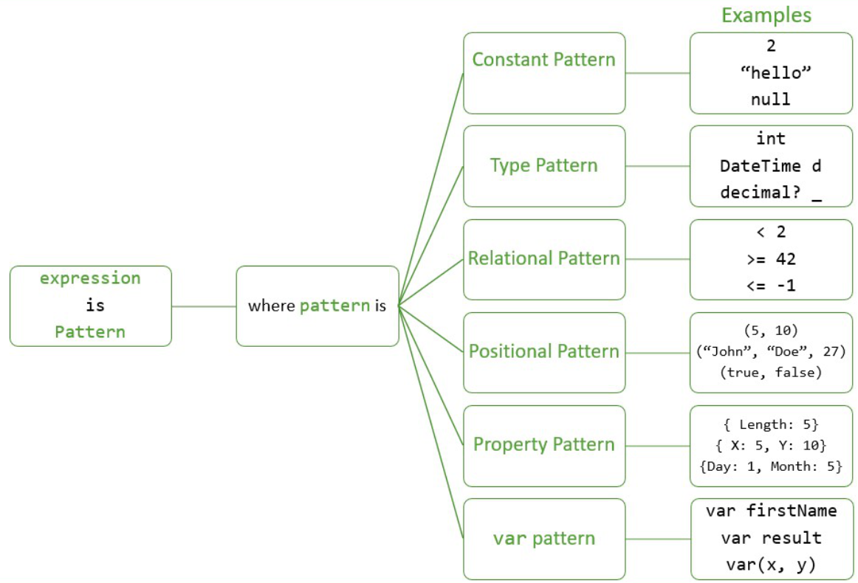
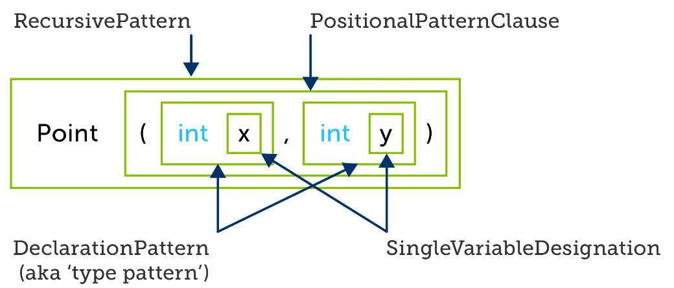
Examples

Slide 8
Last words

Slide 9

Useful links
https://github.com/enKor/PatternMatching
https://learn.microsoft.com/en-us/dotnet/csharp/language-reference/operators/patterns
https://learn.microsoft.com/en-us/dotnet/csharp/fundamentals/functional/pattern-matching

Slide 10

Martin Procházka
prochazka@cngroup.dk
Notes:
Microsoft Certified Professional
Microsoft Certified SLN Developer

